Slide 1


Slide 2


Project Members
Swastik Shresth
Jahanvi Goyal
Pramit Vishwakarma

Slide 3



DayChef is a platform to make our urban lives more fulfilling to solve our needs in a day. Hence the name DayChef.
It enables users to find services like chefs and house keeping. They want to be the g0-to-platform helping customers complete the projects that are important to their lives.

Slide 4
Languages & Frameworks:
Front End:
HTML 5
CSS 3
BOOTSTRAP 4
JAVASCRIPT
ANGULAR
JQUERY
NODE.Js
Back End:
JAVASCRIPT
TYPESCRIPT
JQUERY
EXPRESS.Js
MONGODB
NODE.Js
API

Slide 5

Simple Registration.
Login With Social Media (FB , google+)
Data Security and Safety.
Provide Multiple Payment Options.
Add Service Feedback.
Keep History Of Works Which customer Posted.
Globally Access.
Backup and Restore Facility.

Slide 6


DayChef
Register
Professional
User
LogIn/SignUp
Cook
Maid

Slide 7

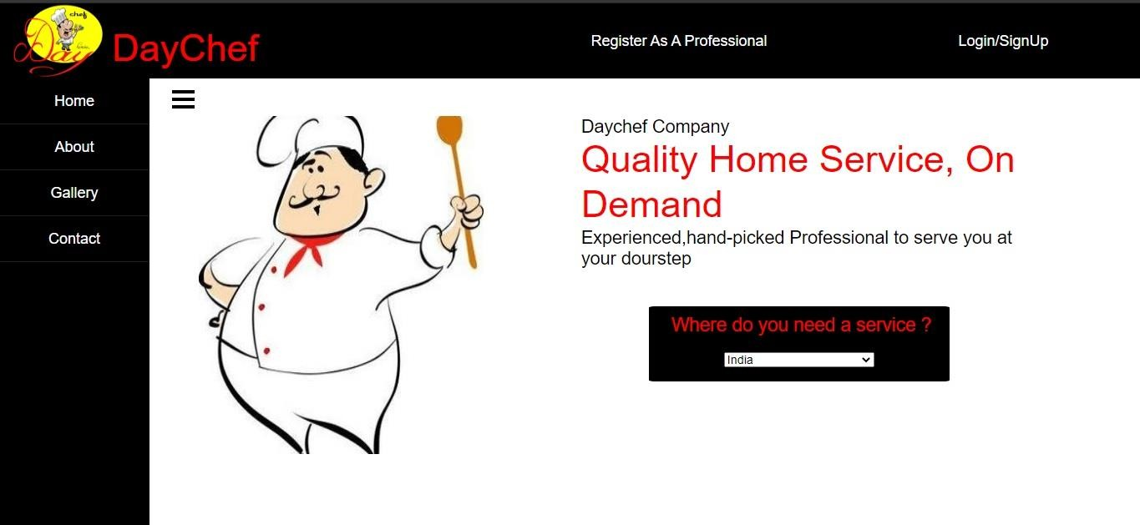
DayChef works on standardized, blue collared services, where you just want the job done, you can directly book and pay for the service.

Slide 8

The most important factor of marketing technique for companies like DayChef is Word Of Mouth. So the most part of promotion involves people talking about it. Other than that we use social media for the promotion by the mode of advertisement.
Target market is divided into different segments say students, working people for example,
For most of the students group there used to be a link in the top right corner of their facebook screens with cooked food images saying ‘Missing Home Cooked
Food’ which created a curiosity among the people

Slide 9
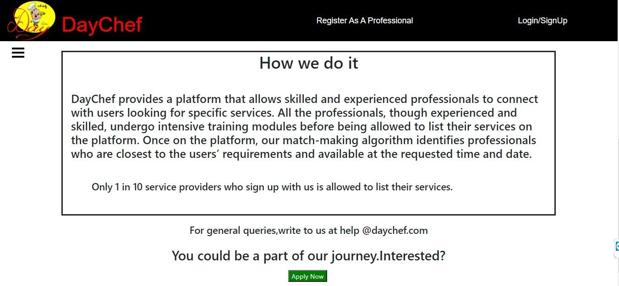
living away from their houses and the fuss having been created they acquired a large share of market in most of the student areas!

Slide 10

1. First step is kept simple and precise for the customers
to understand their services and facilities and how they are to be accessed.

Slide 11
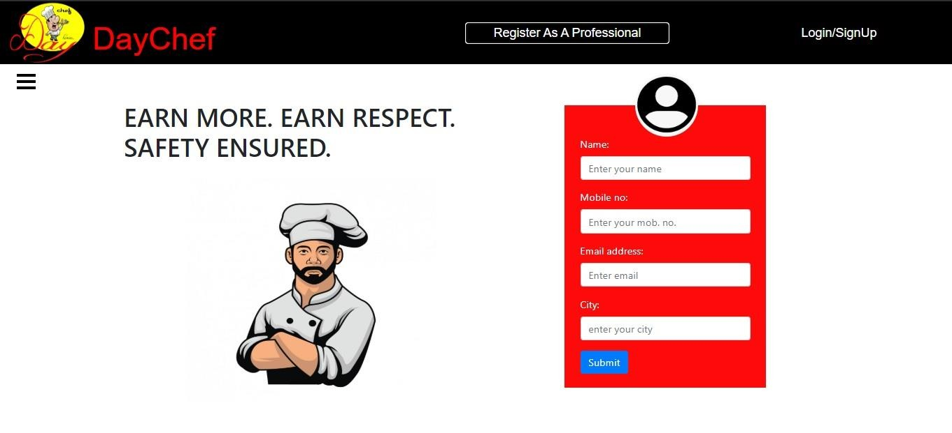
2. If you want to provide your service as a chef then click
on ‘Register As a Professional’.

Slide 12
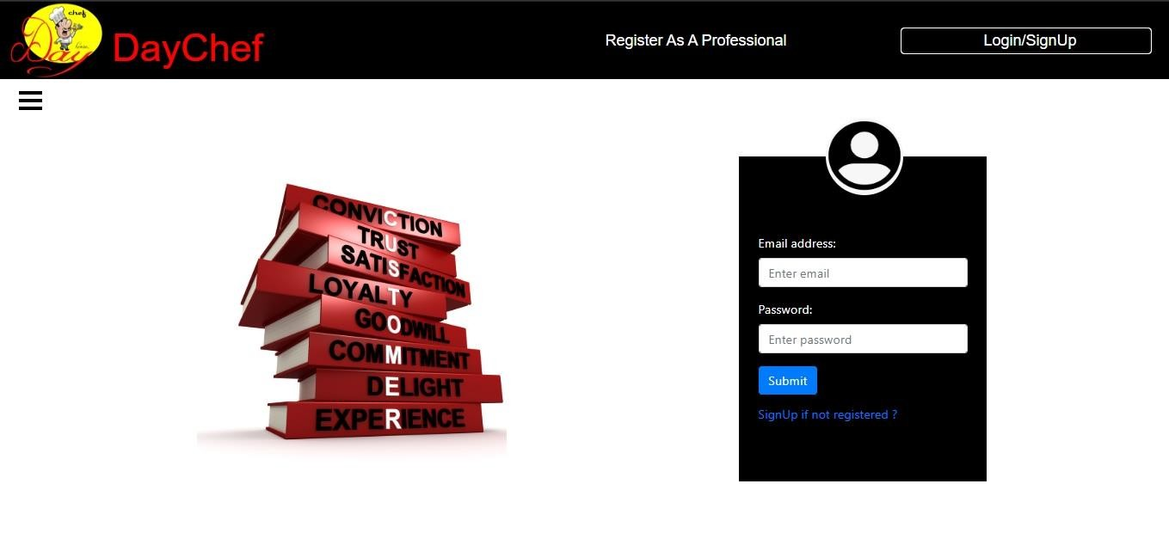
3. If you are a customer ,then click on ‘Login/SignUp’ .

Slide 13
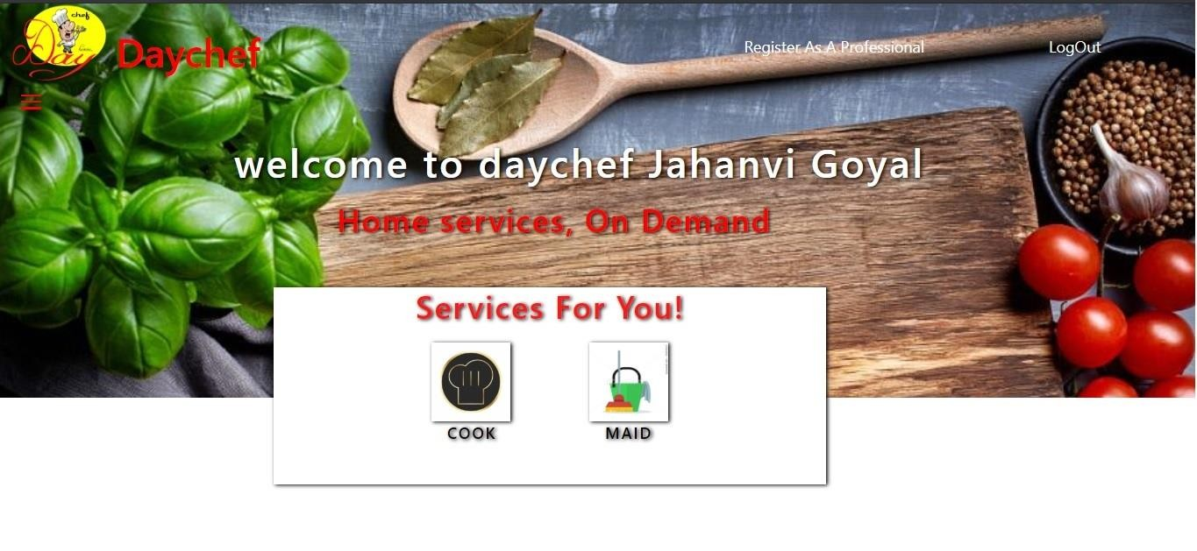
4. After logging in, filter the choices and narrow it
down ,picked up and keep in mind the importance of transparency and the level of the transparency that you are looking for .

Slide 14


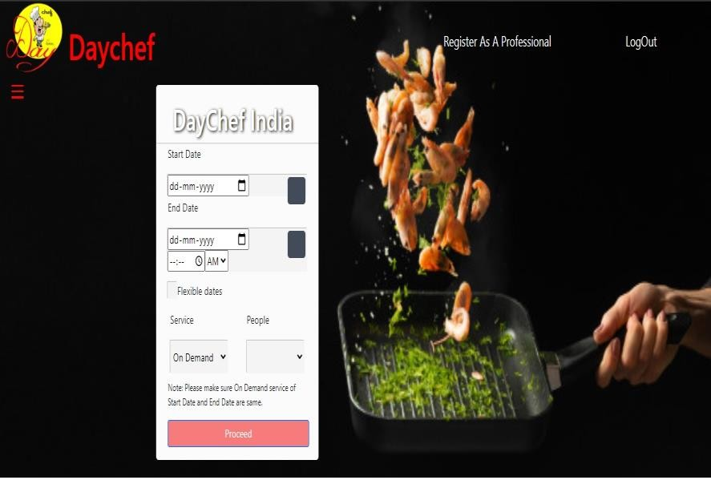
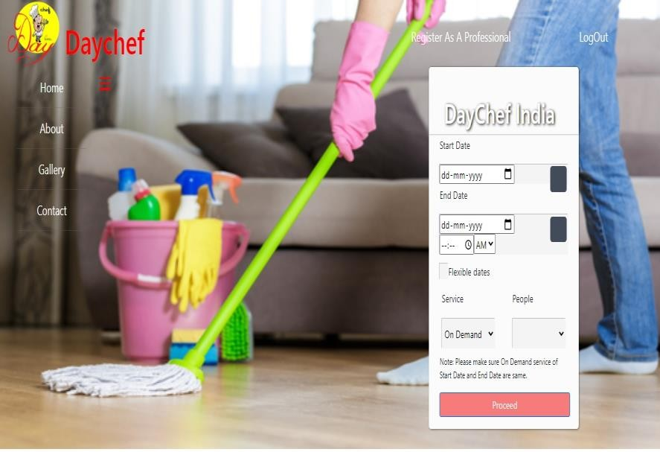

Slide 15
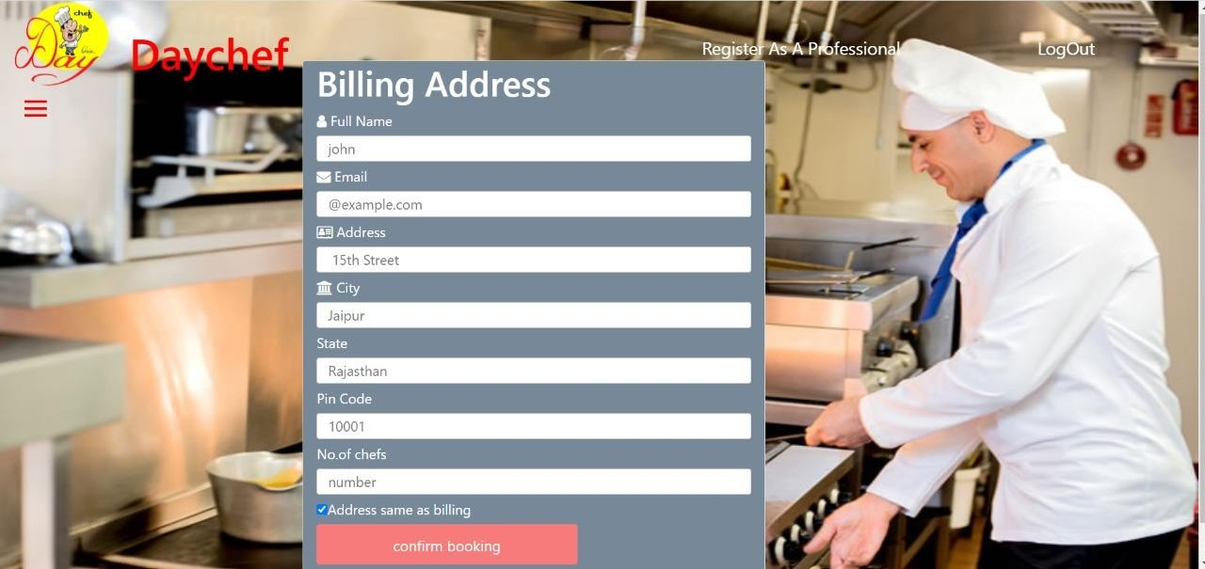
6.After being assured and satisfied ‘Confirm Booking’ .

Slide 16

Trusted Professionals
Guaranteed Service
Ideal for last moment requirements
Direct interaction between the professionals and customers
Wide range of choices
No spam
Budget fits the choices

Slide 17

DayChef is an online platform for customers to scout for the best professionals in the service industry.
Simply put, it connects online users with offline business. Their version is to use technology and smart processes to structure the highly unorganized services market in India and emerging markets. DayChef aspires to make hiring a service professional as easy and straightforward as ecommerce companies have made buying products.

Slide 18
Any Questions

Slide 19

That’s all on our part..!
For being a wonderful audience!!

